Slide 1




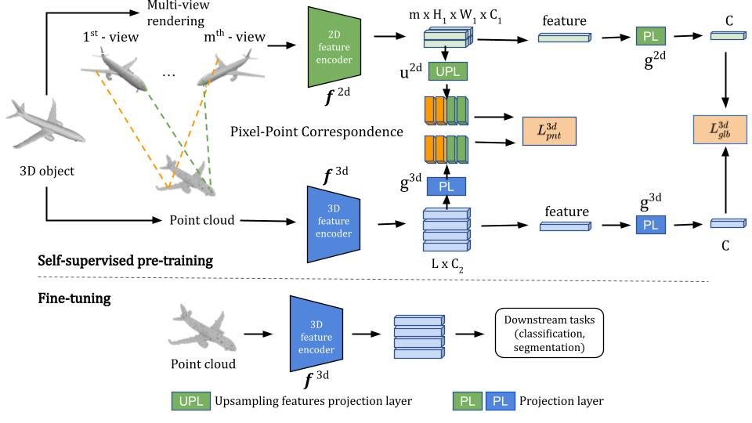
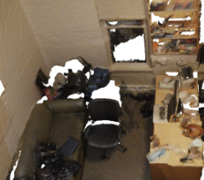
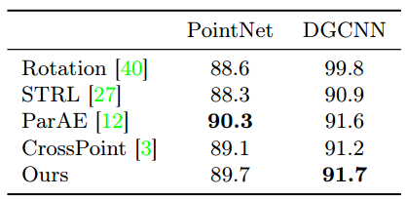
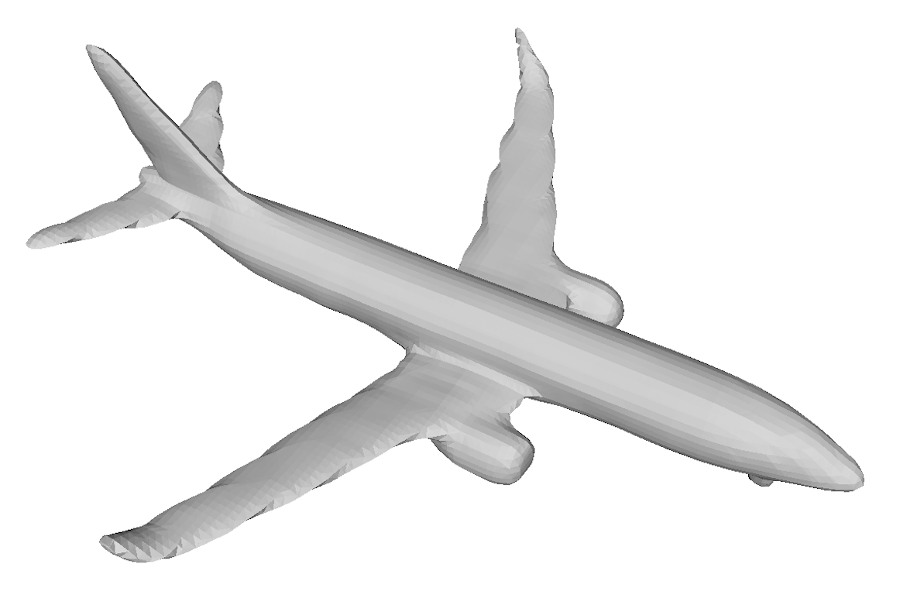
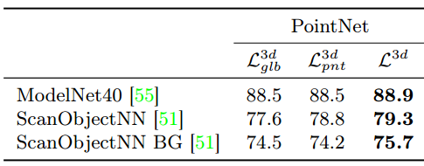
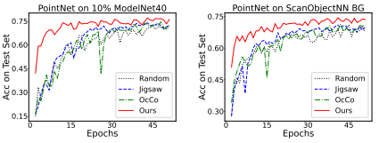
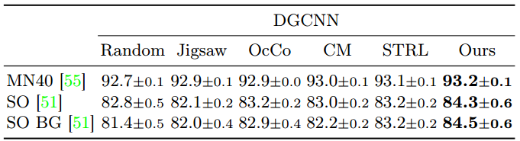
Self-supervised Learning with Multi-View Rendering for 3D Point Cloud Analysis
Bach Tran¹ Binh-Son Hua¹ Anh Tuan Tran¹ Minh Hoai^{1,2}
VinAI Research¹ Stony Brook Univeristy²
1 – Overview
2 – Proposed Framework
3 – Results
Problem statement:
Inputs: 3D data such as mesh, RGB-D
SVM evaluation
Modelnet40
ScanNet
Output: pre-trained 3D models
Previous works:
Jigsaw [1]: based on solving a jigsaw puzzle
OcCo [2]: based on point cloud completion task (similar to mask-based pre-training in NLP)
STRL: based on a sequence of point cloud (spatio-temporal cues)
CM: based on cross-view invariant and cross-modality constraints
Both Jigsaw, OcCo, and STRL ignored information from 2D image
Our proposal: based on a local pixel/point level correspondence and a global image/point cloud level constraint
Loss function
Global knowledge transfer loss: minimizing distance between multi-view 2D feature vector and 3D point cloud feature vector
Point-wise knowledge transfer loss: using a loss function inspired from SimCLR [3] to maximize the similarity between the point representation vector and its correspondence pixel representation vector
Total loss: combining both losses
Learning curve
3 – Results
References
[1]. Sauder, Jonathan, and Bjarne Sievers. "Self-supervised deep learning on point clouds by reconstructing space." Advances in Neural Information Processing Systems 32 (2019).
[2]. Wang, Hanchen, et al. "Unsupervised point cloud pre-training via occlusion completion." Proceedings of the IEEE/CVF International Conference on Computer Vision. 2021.
[3]. Chen, Ting, et al. "A simple framework for contrastive learning of visual representations." International conference on machine learning. PMLR, 2020.
Classification results
4 – Conclusion
We propose a self-supervised method, which:
Based on multi-view rendering
Utilized both global and local knowledge
Outperforms the previous state-of-the-art models

