Slide 1
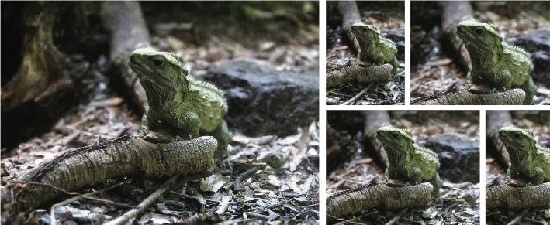
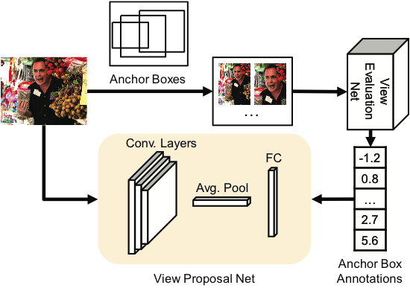
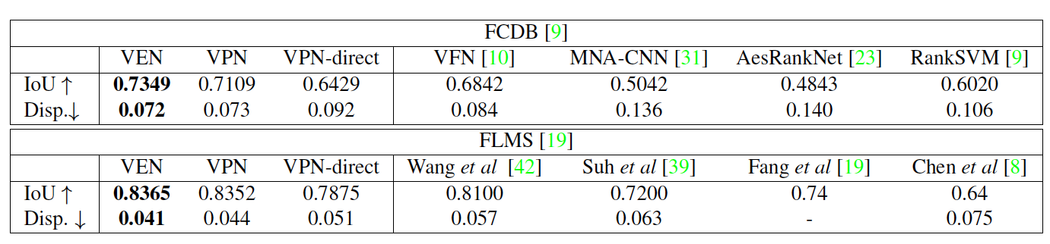
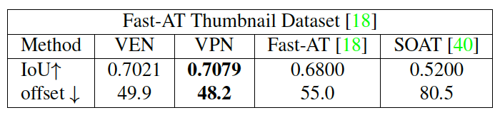
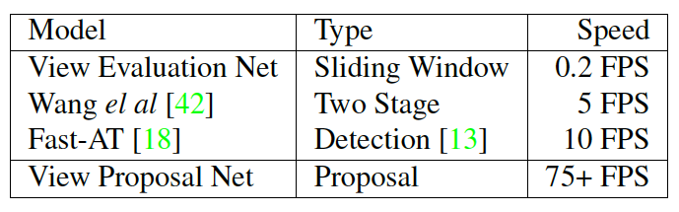
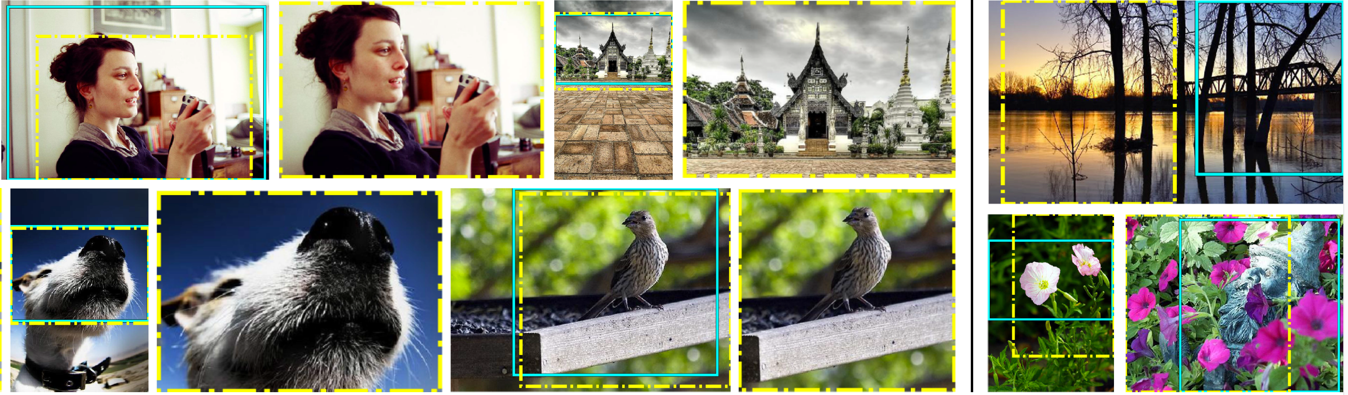

Good View Hunting: Learning Photo Composition from Dense View Pairs
Zijun Wei¹, Jianming Zhang², Xiaohui Shen², Zhe Lin², Radomír Měch², Minh Hoai¹, Dimitris Samaras¹
¹Stony Brook University, ²Adobe Research
zijwei@cs.stonybrook.edu
Suggesting Good Compositions
The Comparative Photo Composition Dataset (CPC)
Motivation:
Properties:
A large range of scenes covering various number of objects.
Each image contains 24 user-ranked views.
More than 1,000,000 view pairs can be generated.
data collection
pipeline
Teacher-Student Knowledge Transfer for Real-Time Proposal
Experimental Results
The Teacher Net:
View Evaluation Net (VEN)
Takes an image, outputs a score for the image
Trained by ranking pairs
Quantitative Results
Task: Given an image, suggest views with good compositions
Challenges:
It is a subjective task with various criteria;
An image can have multiple good composition views;
Subtle displacement may greatly change the composition quality;
Needs to be in real-time for smooth user-experience.
Image Cropping
The Student Net:
View Proposal Net (VPN)
Takes an image, outputs N scores for N candidate locations
Trained by the teacher net
A novel loss function (see paper)
Image Thumbnailing
Efficiency
Our contributions
The large scale Comparative Photo Composition (CPC) dataset;
A novel knowledge-transfer framework to train a real-time good composition view proposal network (VPN) that works at 75+ FPS.
Ground-truth
VPN suggestion
Also works for panoramas
High IoU (red) does not indicate high composition quality
Low IoU (yellow) does not indicate low composition quality
For more comparisons, user studies, please checkout our paper
Acknowledgements:
This project was partially supported by a gift from Adobe, NSF CNS-1718014, the Partner University Fund, and the SUNY2020 Infrastructure Transportation Security Center
datasets,
code,
models:
Notes:
Cyan

